Slide 1

American Council of Engineering Consultants
The City & County of Honolulu
Capital Improvement Program
Smarter Cities
Initiative
Top Projects
April 6, 2017
Robert J. Kroning, P.E., Director
Department of Design and Construction

Slide 2
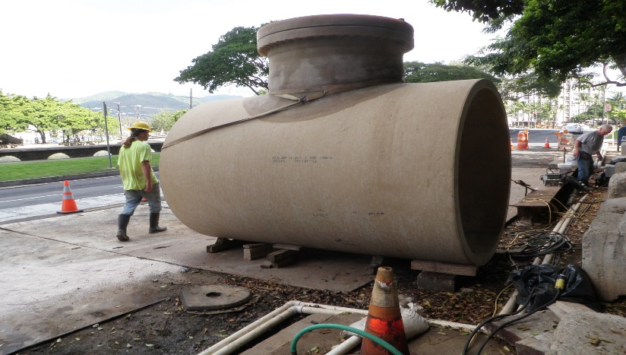
Purpose
To inform the American Council of Engineering Consultants of Hawaii about the City’s Capital Improvement Program
And maybe recruit some new talent to join the City!
Notes:
2

Slide 3

Mayor’s Priorities
Restore needed bus routes
Build rail better
Wastewater upgrades
Road paving
Park improvements
Homelessness solutions
Notes:
3

Slide 4

DDC Organization
DIRECTOR
Robert Kroning
DEPUTY DIRECTOR
Mark Yonamine
ADMIN
CIVIL
DIVISION
Chief
Stan Katsura
Asst. Chief
Tim Trang
FACILITIES
DIVISION
Chief
Clifford Lau
Asst. Chief
Dennis Kodama
MECHANICAL/
ELECTRICAL
DIVISION
Acting Chief
Allyn Lee
WASTEWATER
DIVISION *
Chief
Guy Inouye
Asst. Chief
Wes Yokoyama
LAND
DIVISION
Chief
Scott Shigeoka
Mission Statement: To provide engineering expertise and advice to the City’s programmatic planning and perform project planning, design, construction, inspection, and land acquisition for public facilities of the City and County of Honolulu.

Slide 5
DDC CIP Funding
Notes:
Projected for FY 2014. 2014 CIP budget signed by Mayor and council in June 2013.

Slide 6
CIP Project Types
General Facilities: Corporation Yards Municipal Offices Municipal Parking Structures Morgue Police Stations Fire Stations Ambulance Facilities Lifeguard Towers Bus Facilities Parks Enterprise Venues (Blaisdell, Shell) Honolulu Zoo City Golf Courses Communications Structures Other Miscellaneous City Facilities
Street Right-of-Way Features
Drainage Systems
Flood Control Structures
Rock Slide Mitigation
Bridges
Street Lighting
Wastewater Systems
Mechanical/Electrical Systems
NPDES

Slide 7
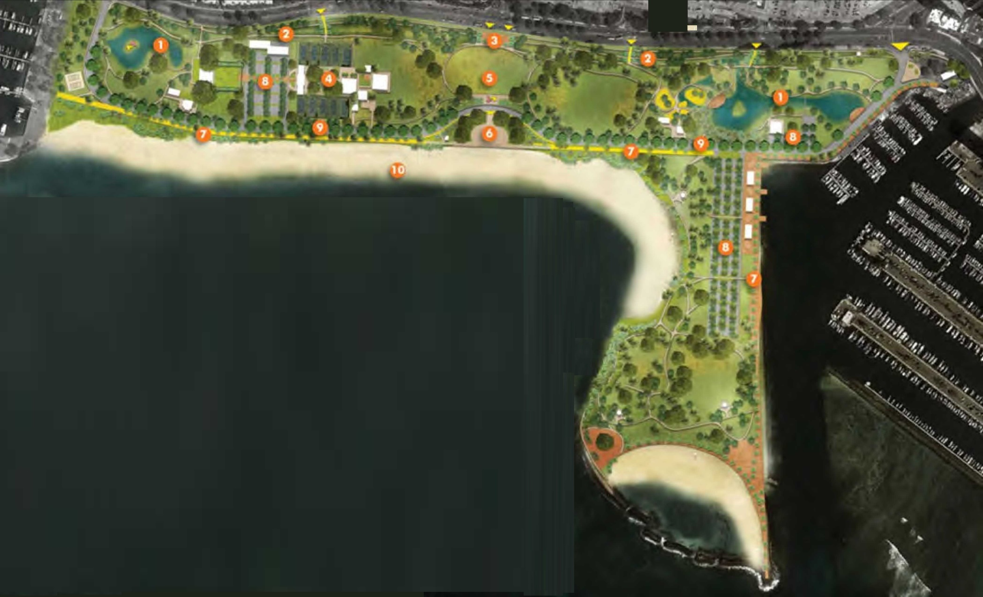
Ala Moana Regional Park
Master Plan – EIS: Mid - 2018
Projects Completed or in Construction:
  Irrigation System Renovations
  Sand Volleyball Courts
  Improvements Along Ala Moana Blvd
  Concession & Comfort Station LED Lighting
  Sand Pushing/Beach Restoration
  Magic Island Path Repairs
Potential Future Improvements:
  Diamond Head Bathhouse Improvements
  Magic Island Outdoor Shower Improvements
  Magic Island Parking Lot Reconstruction
  Magic Island Exercise Equipment
  * Sand Replenishing & Canal Improvements
  * Parking Structure
  * Promenades
* EIS Dependent

Slide 8
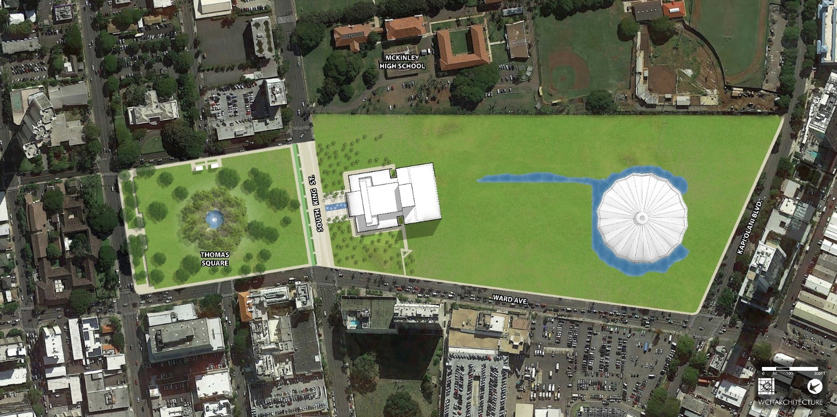
Neal S. Blaisdell Center
Feasibility Study Complete
Master Plan & Conceptual Design Phase Ongoing
Potential Future Improvements:
  Parking Structure – increase capacity and possibly include automated parking facility
  Exhibition Hall – Demo and build new Hall that also has office, retail and storage spaces
  Concert Hall – Increase seating capacity, add new multi-purpose venue, improve lobby, and overall upgrade/refresh
  Arena – Increase seating capacity, create additional back of house space, and overall upgrade/refresh
  Victoria Street – Create shared street along property
  Kapiolani Blvd – Incorporate complete streets elements, activate site perimeter to attract increased use of facilities
  Grounds – Add public art and gathering places
  Connections to Thomas Square Park
Notes:
8
Consultant : AECOM ($350,000);
Current Status: consultant completing economic assessment. Initial alternatives to be presented this fall

Slide 9
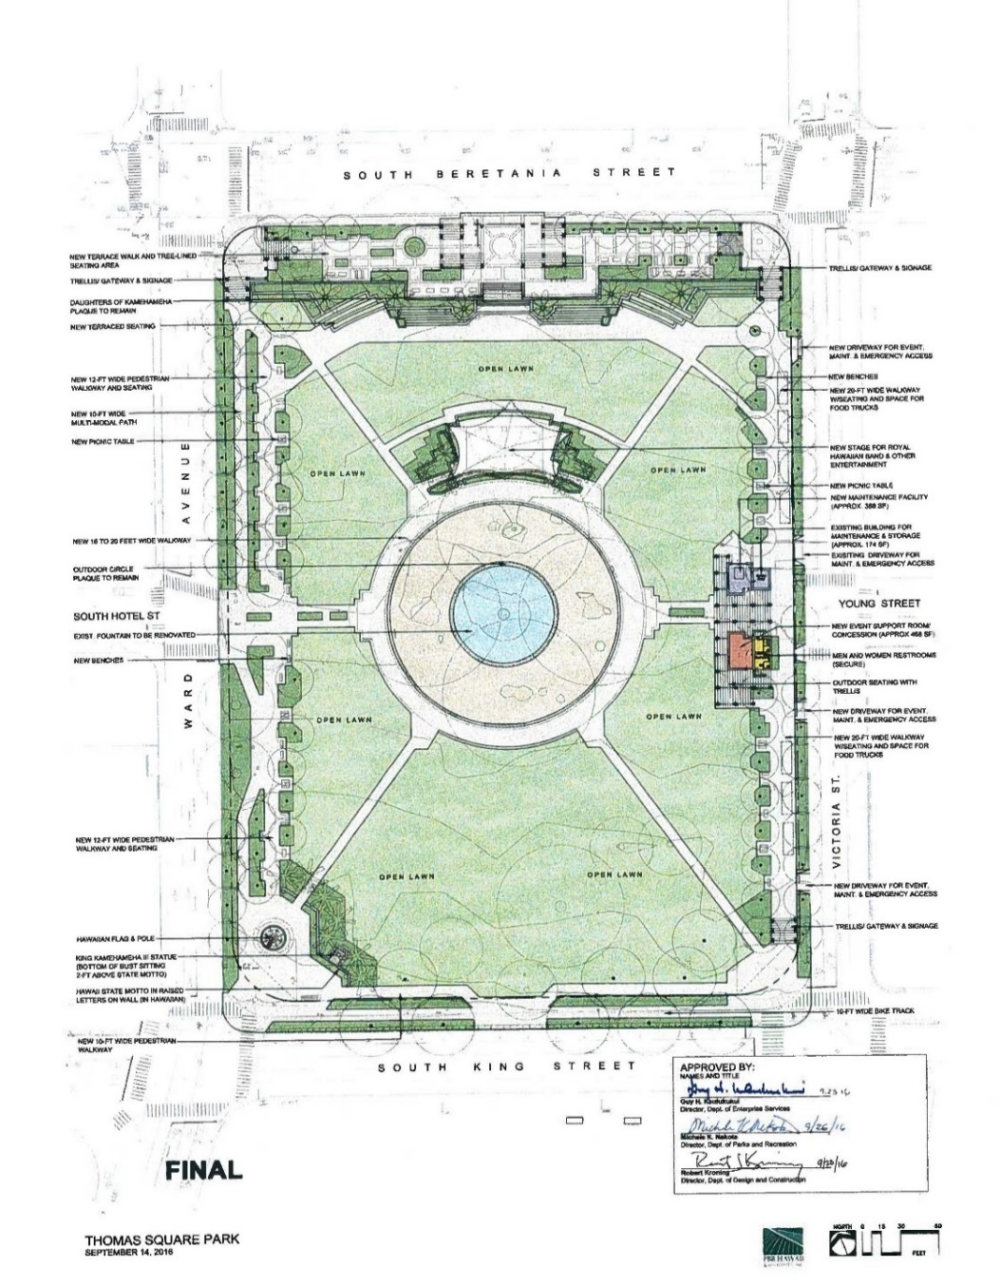
Thomas Square Park
Master Plan – EA Complete
Phase 1:
  Irrigation and grassing
  Hedge and deficient tree removal
  Center Banyan trimming
Phase 2:
  King Kamehameha III statue
  Flagpole
  State Motto mounted on low rock wall
  Comfort station renovation
  Bike and walking paths
  Grand stairs
  Upper terrace revitalization
Potential Future Improvements:
  Bandstand

Slide 10
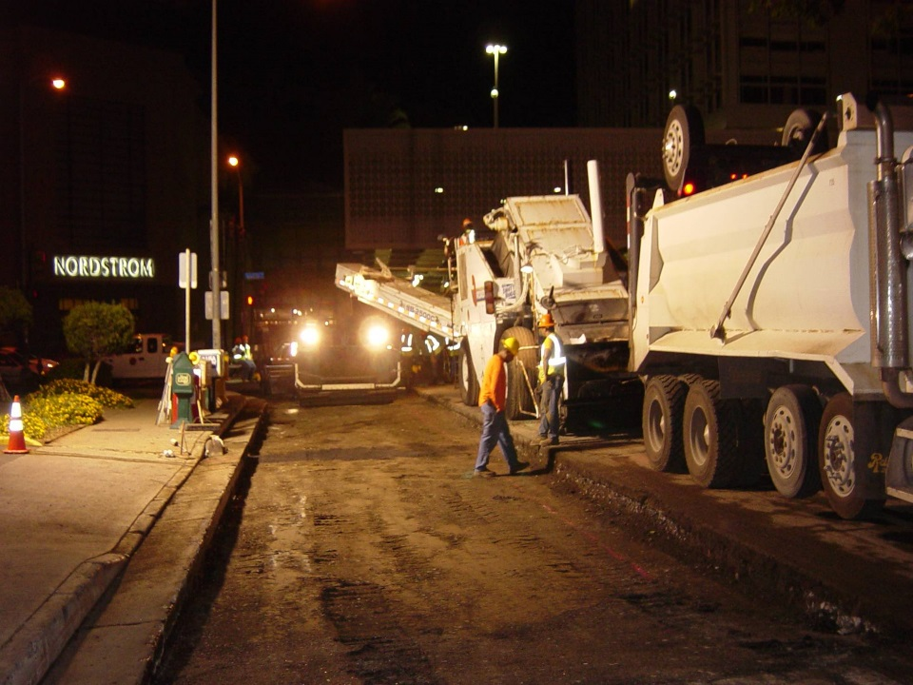
Rehabilitation of Streets
Lane Miles Paved
398
305
256
332
300 (Projected)
Requirements v Priorities v Resources
Survey and Pavement Condition Management:
  Right-of-Way imaging every two years (earthmine)
  MicroPaver management system
  Seal coats
Paving Challenges - Solutions:
  Shallow utilities – Consultant exploration
  Poor subgrade – Reconstruction
  New regulations (NPDES) – Training & Oversight
  Conflict Management – Lokahi

Slide 11
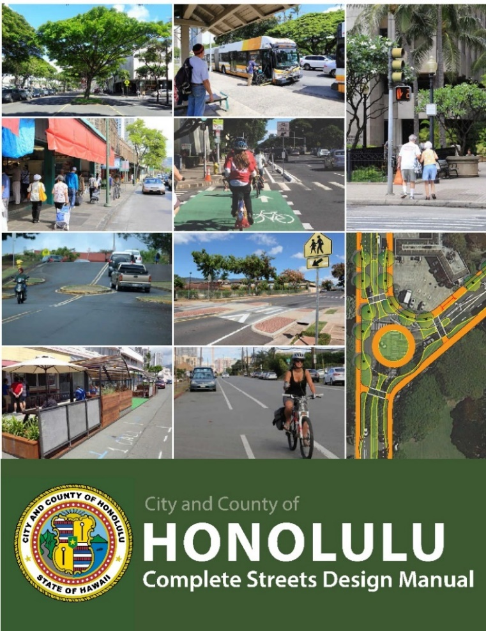
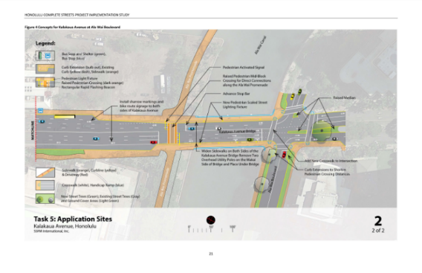
Complete Streets Program
Law: ROH Chapter 14, Article 33
Principles:
  Improve safety
  Solution process that integrates community
  Protect & promote accessibility/mobility
  Balance needs & comfort of all users
  Encourage use of best practice guidelines
  Improve energy efficiency – provide non-motorized transportation options
  Recognize health benefits of active lifestyle
  Recognize complete streets as long term investment that saves money over time
  Build partnerships with stakeholders
  Incorporate trees & landscaping
Progress:
  Created a Complete Streets Team
  Developed a multi-departmental SOP
  Incorporate into all projects that touch the right-of-way
  Road Diets – Kamehameha IV & Ala Napunani
  Pilot Projects:
    Reverse Angle Parking – Ulune
    Curb Extensions – S. King and Eisenberg
    Protected Bike Lane – S. King & South

Slide 12
Kapālama Canal
Transit Oriented Development (TOD)

Slide 13
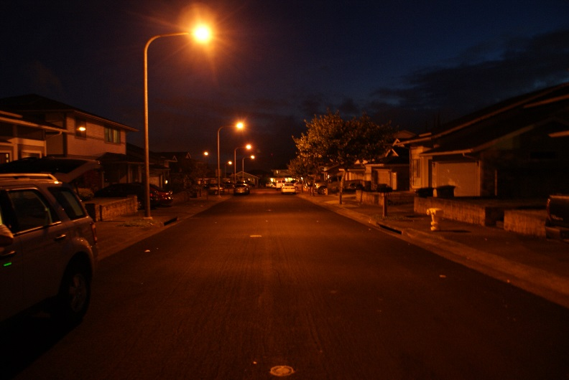
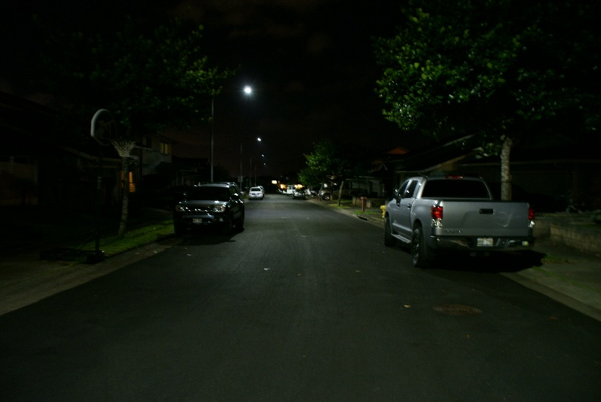
LED Street Light Conversion
Features:
  Convert over 53,000 street light fixtures to LED
  No capital required, funded through energy savings
  Anticipated $3M-$4M in annual savings
  Network control system:
    Meter power to each fixture
    Dimming
Considerations:
  Blue light effects on telescopes and humans
    Majority of lights will be 3000K CCT
    Directional quality of LED reduces light trespass
  Effects on wildlife
    Directional quality is preferred
    Supported by US Fish and Wildlife
  Glare
    Design specification reduce/prevent glare
Additional Project Requirements:
  Create a City street light inventory
  Adaptable network control system capable to add:
    Cameras
    Cell and/or wireless
    Noise and motion detection

Slide 14
Kaneohe-Kailua Tunnel
Notes:
14
Where we’ve been:
- late 70’s – plant started operations
- mid/late 2000 – expansion – new clarifiers, odor control, headworks – solids handling, UV disinfection
- within last few years – upgrades to gravity thickener, odor control, clarifiers, new digester
Where we’re going – upcoming larger projects
- Projects that are under design – SI Odor Control improvements, work at Outfall; SI Improvements/Upgrade, work at Solids Facility,
- Headworks screening (T&D-executed project)
- Return Flow Treatment - $20+M project
- Facility planning continues – looking at secondary treatment planning, primary treatment alternatives, utilities, solids, others
- Secondary – awaiting facility planning results
- GCD milestones
- Jan 2019 – execute design contract
- Jan 2022 – execute construction contract, first phase
- Dec 2035 – compl construction; can be delayed to Dec 2038 due to financial hardships

Slide 15
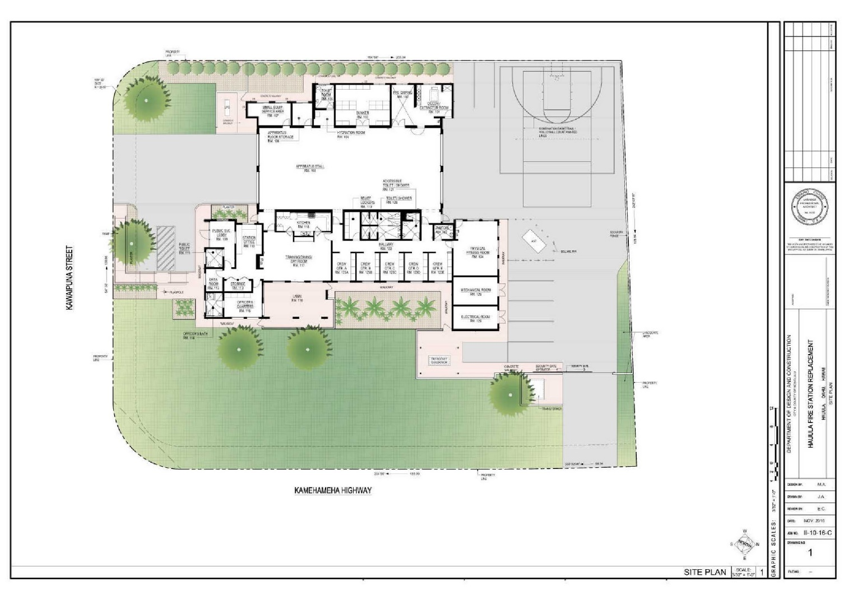
Hau’ula Fire Station
Construction Bid Opening: 6 Apr 2017
Estimated Cost: $7M
Features:
  Outside of Coastal High Hazard Zone
  Sized to accommodate on site training
  New calming alert notification system
  Interior spaces that separate conflicting activities

Slide 16
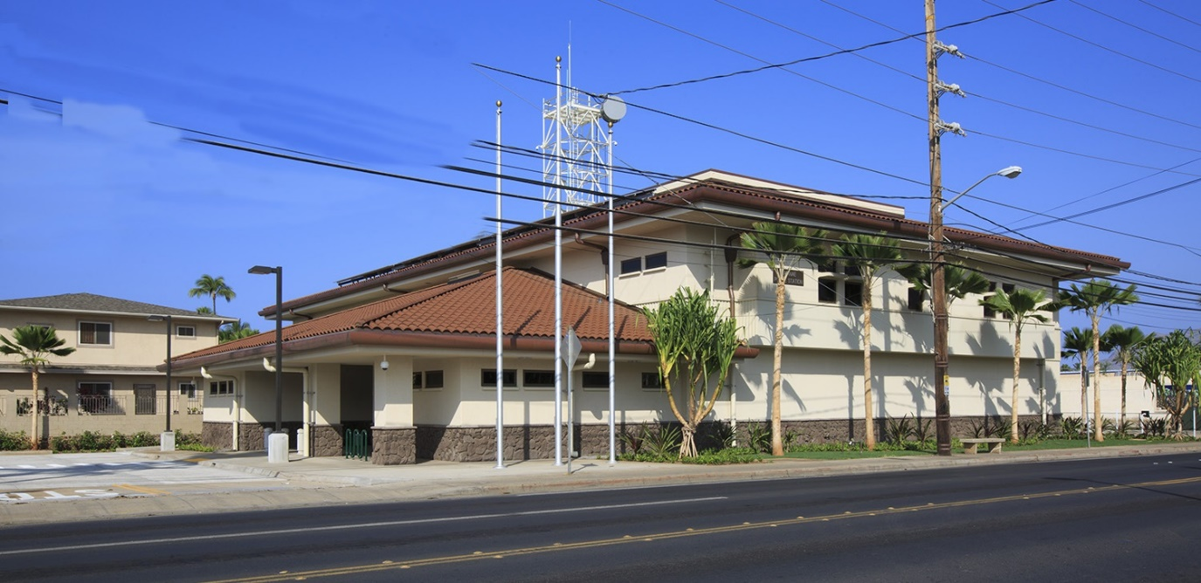
Waianae Police Station
Completed: Dec 2015
Cost: $16.5M
Features:
  Over three times larger than previous station and allows for upper floor expansion
  Certified LEED Silver
    Pervious concrete parking lot
    Bicycle storage
    Solar roof
  On site fueling station
  Upgraded comms system

Slide 17
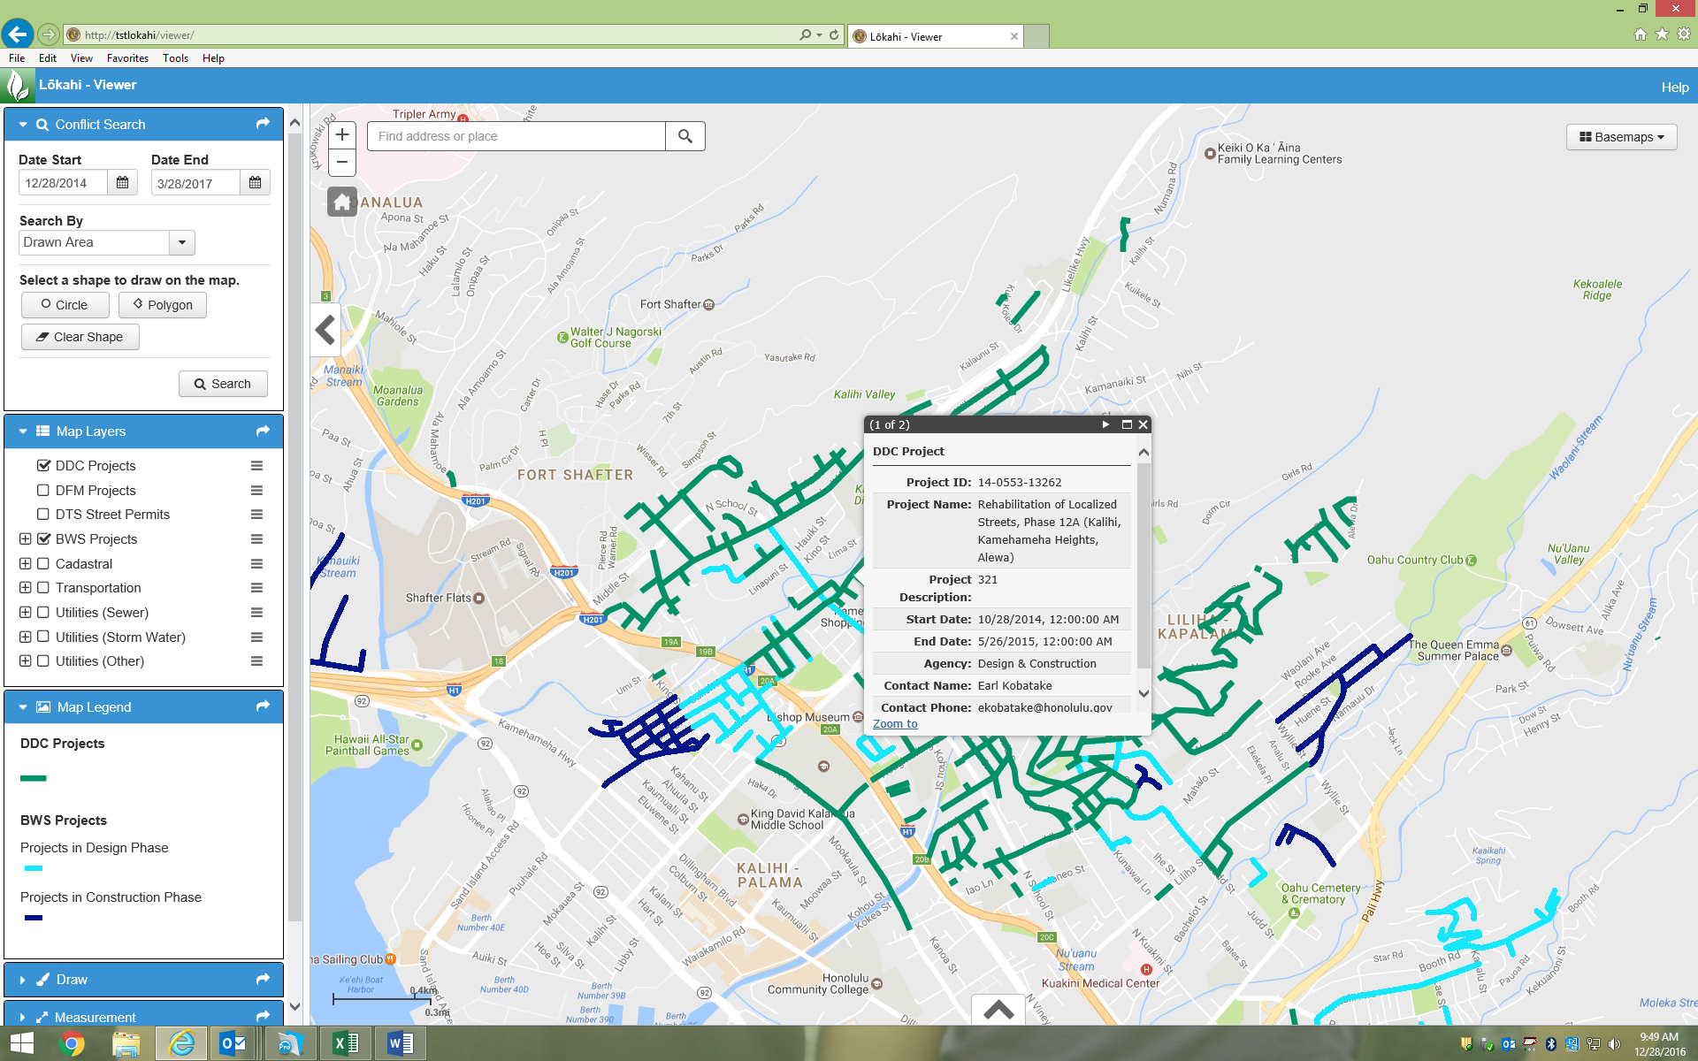
Conflict Management Program
Lokahi

Slide 18
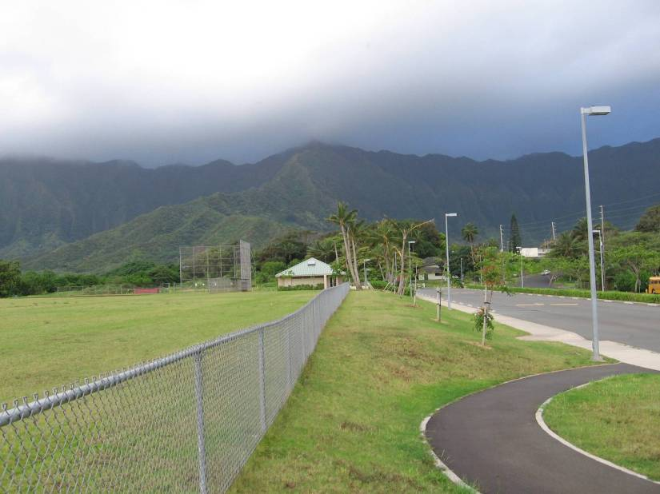
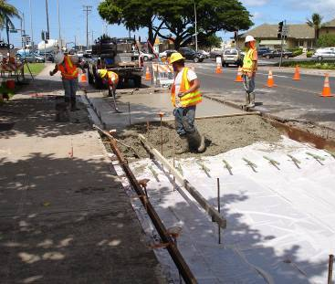
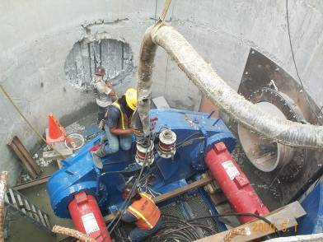
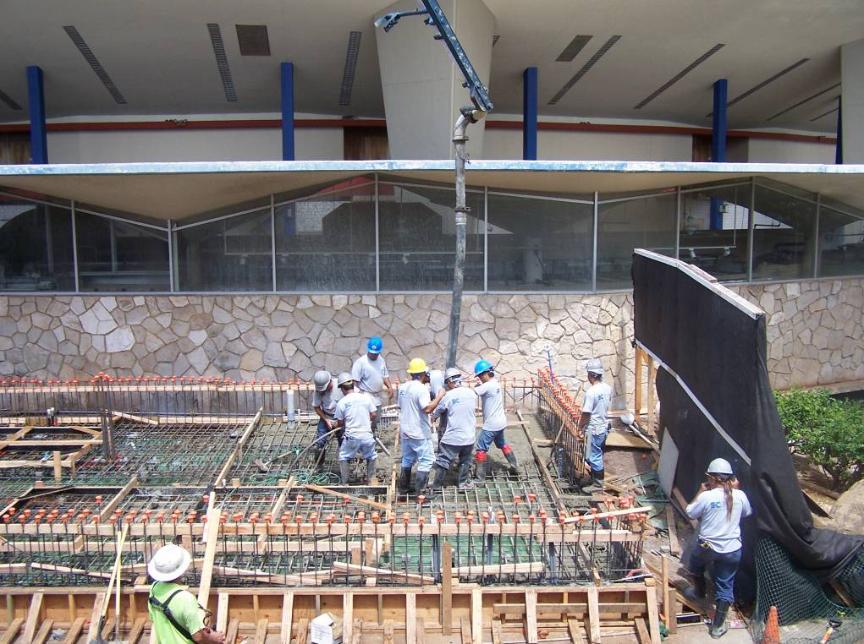
Thank You!

