Slide 1
ACEC Honolulu
County of Hawaii, Department of Environmental Management

Slide 2
County of Hawai’i Department of Environmental Management (DEM)
Structure
Solid Waste Division
Hilo Landfill (East Side)
Puuanahulu Landfill (West Side)
Recycling
Transfer stations (21)
Abandoned vehicles
Waste Oil
Tires
Household Hazardous Wastes
HI5 Program
Electronics

Slide 3
County of Hawai’i Department of Environmental Management (DEM)
Waste Water Division WWTF
Hilo 5.0 mgd
Kealakehe (R1) 5.3 mgd
Paukaa & Papaikou 0.35 mgd
Pepeekeo 0.5 mgd
Kapehu Camp
Honokaa 0.2 mgd

Slide 5
CIP Proposed Budget 2017-2018
Project
2017-2018
Total est. cost
1. Hilo WWTF Concrete Rehabilitation
2. Kealakehe R1 Upgrade
3. Pua Sewage Pump Station- Pump Replacement
4. Rural Transfer station replacement/enhancement
5. North Kona Effluent Reuse System
6. Na’alehu Wastewater System
7. North Kona Sewer
8. Green Waste Hawi`
1. $ 10 million
2. $ 27 million
3. $ 2.3 million
4. $ 2 million
5. $ 0.6 million
6. $ 1 million
7. $ 3 million
8. $ 0.5 million
1. $ 10 million
2. $ 54 million
3. $ 2 million
4. $ 15 million
5. $ 8 million
6. $ 13 million
7. $ 20 million
8. $ 0.5 million

Slide 6
CIP Proposed Budget-Future
Project WW
Year Anticipated
Total Anticipated Budget
9. Repair Hilo Digesters
10. Primary Sludge Pump & DAFT retrofit
11. Kaumanu Gardens Collection Sewer
12. Ainako Aina Nani Collection sewer
13. Ainako Interceptor Ph 2
14. Kalanianaole Sewer Ph2
15. Modify Hilo Digester
9. 2018-2019
10. 2018-2019
11. 2018-2020
12. 2018-2020
13. 2018-2020
14. 2019-2021
15. 2020-2022
9. $ 15 million
10. $ 20 million
11. $ 5.75 million
12. $ 4.6 million
13. $ 3.6 million
14. $ 4.6 million
15. $ 10 million

Slide 7
CIP Proposed Budget-Future
Project SW
Year Anticipated
Total Anticipated Budget
16. Landfill Closure-Hilo
17. Hilo Scrap metal Closure
18. Replace Kona base yard
19. Improve E Hawaii Sort Station
20. Replace Waimea base yard Bldg
21. Landfill gas collection-WHLF
22. Replace Hilo Disposal Area
16. 2018-2019
17. 2018-2019
18. 2018-2019
19. 2018-2020
20. 2018-2020
21. 2019-2020
22. 2019-2020
16. $ 20 million
17. $ 7 million
18. $ 0.5 million
19. $ 0.7 million
21. $ 3.6 million
21. $ 2 million
22. $ 3 million

Slide 8
CIP Proposed Budget-Future
Project
Year Anticipated
Total Anticipated Budget
23. Multiple Upgrade and replacements WW
24. Multiple Upgrade and replacements SW
23. 2020-2022
24. 2020-2024
23. $ 17.2 million
24. $ 16.0 million

Slide 9
R1 water Treatment
Kealakehe Treatment facility

Slide 11
Kealakehe Treatment Facility – R1
WWTP for Kailua-Kona
5.3 million gallons per day ultimate capacity
Constructed early 1990s
Aerated lagoon system
Current flows are about 1.7 million gallons per day
Endangered birds

Slide 12
Kealakehe Treatment Facility – R1
Recycling elements
R-1 recycled water treatment
UV Treatment
Recycled water irrigation
WWTP buffer parcel
Off-site use
Disposal elements
Subsurface flow constructed wetlands
Soil aquifer treatment system

Slide 15
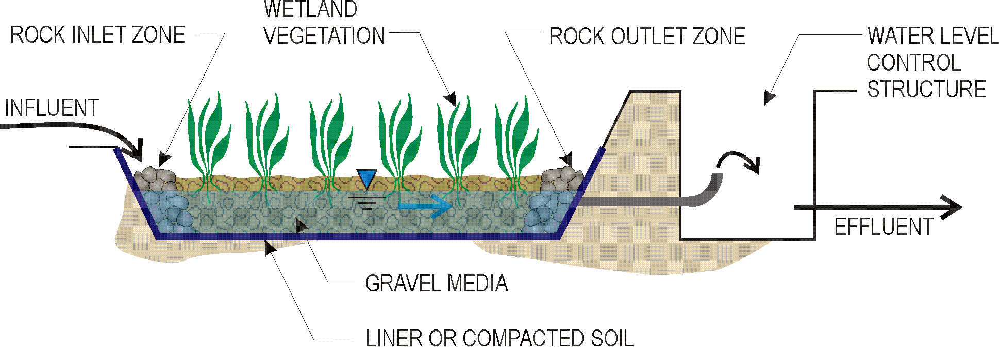
Subsurface Flow Constructed Wetland Provides additional treatment Nutrient removal Metals removal Trace organic compound removal

Slide 16
Soil Aquifer Treatment (SAT)
USEPA recognized form of land treatment
Removal of:
BOD and TSS
Pathogens
Nutrients
Trace organic compounds
Metals
Endocrine disrupters

Slide 17
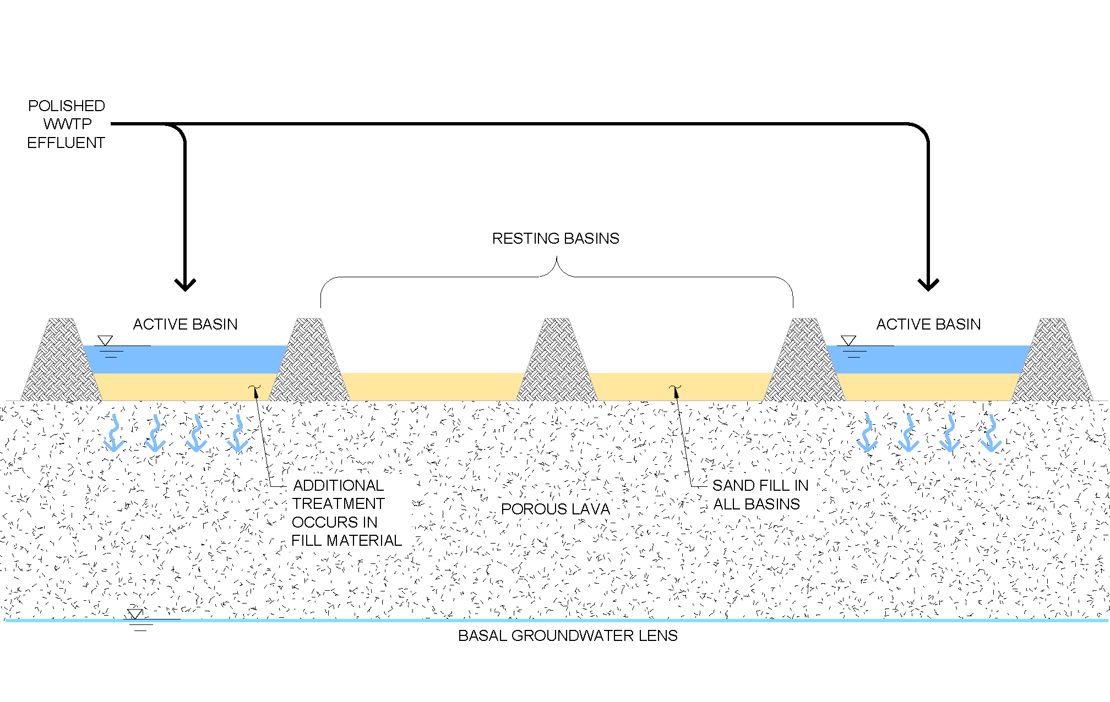

Slide 18
Kealakehe Treatment Facility – R1
Total project cost: $48M
State Revolving Fund loan
Benefits:
Water reuse extends our water resources
Significant reduction of nutrient loads to groundwater
Recognized form of land application for excess water disposal

