Slide 1
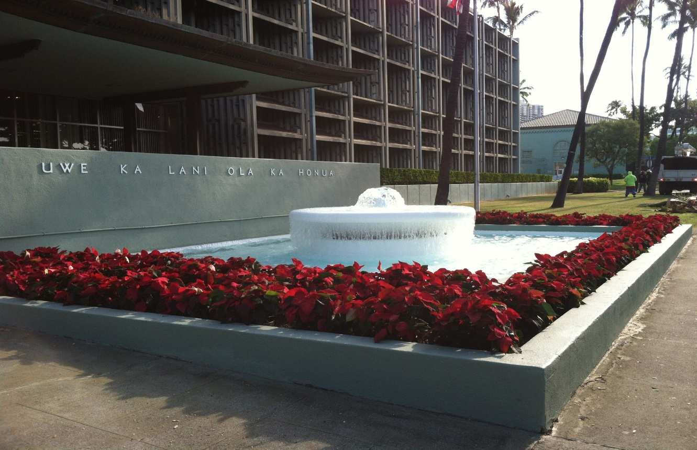
ACECH, City, County and State Symposium
Ernest Y. W. Lau, Manager and Chief Engineer, P.E.
April 6, 2017
Executive Matters and Legal Affairs Committee Meeting
September 16, 2014

Slide 2
BWS Vision and Mission
Vision: ‘Ka Wai Ola – Water for Life’
Mission: To provide safe, dependable, and affordable water now and into the future
Notes:
This is our core vision and mission for our utility. We are entrusted with this responsibility and it is our kuleana!

Slide 3
Oct 2016
Notes:
A key foundational effort over the past few years has been the development of a long term master plan.
We engaged in a rigorous 3-year process to develop the Water Master Plan (WMP) with the help of a remarkable Stakeholder Advisory Group.
Importantly, the BWS Board of Directors adopted the Water Master Plan in Oct. 2016. The Board has set the planning policy direction for our utility going forward.
This is the cover of the summary of that plan which is the mural in the BWS Engineering Building lobby by Juliette May Fraser in 1940.
Here are a few highlights of the Plan.

Slide 4
The BWS Water Master Plan…
… Looks ahead 30 years
… Evaluates the entire water system
… Identifies necessary improvements
… Balances needs with costs of providing water to our customers
Notes:
The BWS Water Master Plan -
Looks ahead 30 years,
Evaluates the entire water system,
Identifies necessary improvements,
and Balances needs with costs of providing water to our customers.

Slide 5
Water Master Plan-Water Rate Schedule
2013
2014
2015
2013
2014
2015-2016
2017-2018
Phase 1:
Initial Evaluation,
WMP Methodology & Ph. 2&3 Scope
Phase 2: Condition Assessment &
System Analysis
Phase 3: 30-year CIP, Water Master Plan &
Stakeholder Advisory Group
Financial
Plan
&
Rate
Study
We are here
Notes:
We are continuing to move along with the Water Master Plan
Master Plan was adopted in October 2016
Work is underway on the Financial Plan and Rate Study
The WMP has many moving parts and the original scope was developed more than two years ago.
We anticipate water rate adoption in mid-2018 and effective January 2018.

Slide 6
The BWS Water Master Plan…
Looks ahead 30 years
… Evaluates the entire water system
… Identifies necessary improvements
… Balances needs with costs of providing water to our customers

Slide 7
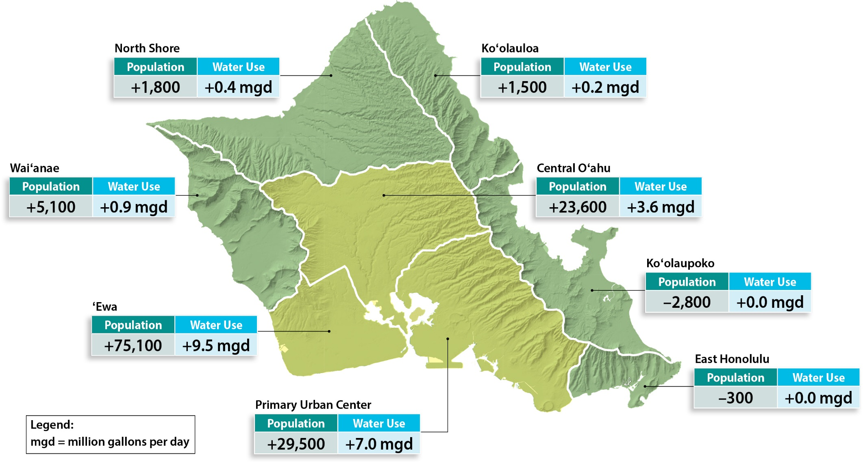
Changes in Population and Water Use Projections by 2040
Notes:
Part of looking ahead is figuring out where people are likely to live, and how much water they’ll need.
Even though we are 1 island, there are big differences with respect to water from place to place.
Some areas are expect to grow only a little, or not at all. Most of the growth and most of the increased water use will happen in Ewa, Central, and the lower part of the Primary Urban Center – basically from downtown through Waikiki and out to Hawaii Kai.
By 2040, the Board of Water Supply expects to deliver an additional 17 million gallons per day to Ewa and the Primary Urban Center.

Slide 8
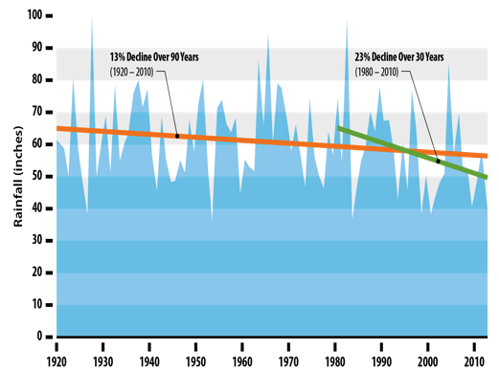
Climate change and other trends were factored into the plan’s recommendations
Notes:
Climate change is one of the trends and uncertainties that will impact our water system.
Notice the steepness of the green line compared to the orange line. That shows a steeper dropoff of the amount of rain we have gotten in the past 30 years compared to the previous decades. We don’t know if that steep decline will continue, but we are closely involved in climate change research and taking that research into account in our future plans.

Slide 9
The BWS Water Master Plan…
Looks ahead 30 years
Evaluates the entire water system
… Identifies necessary improvements
… Balances needs with costs of providing water to our customers

Slide 10
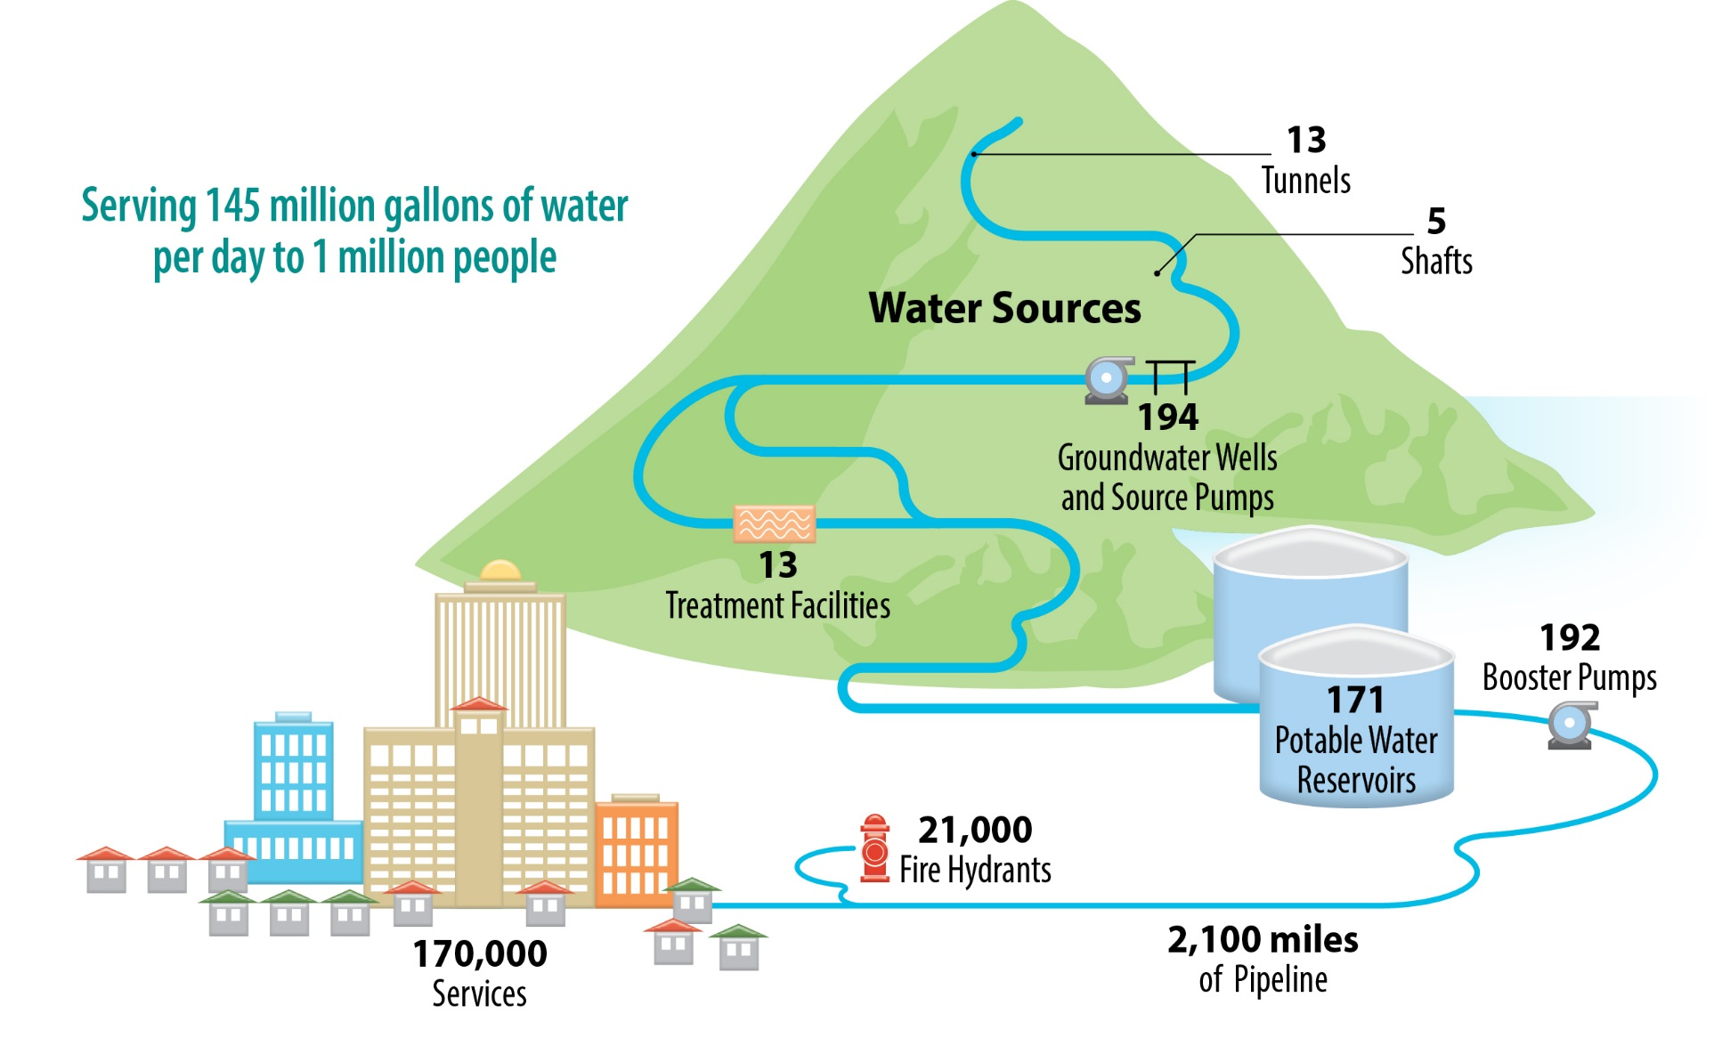
The BWS Water System is Large and Complex
Notes:
Then we evaluated the entire BWS water system
The water system is one of the larger ones in the United States. We deliver around 145 million gallons of water every day to about 1 million people. We looked at whether or not our 2,100 miles of pipelines, 171 reservoirs, and 192 pumps were large enough and in the right places to move, pump and store water for our future population.
The evaluation leveraged science and technology to give us valuable information for current and future planning.

Slide 11
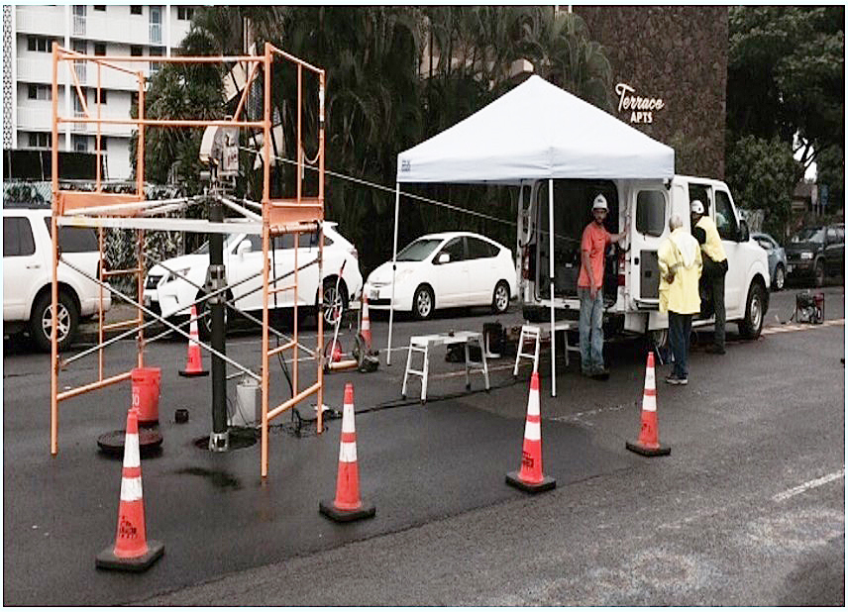
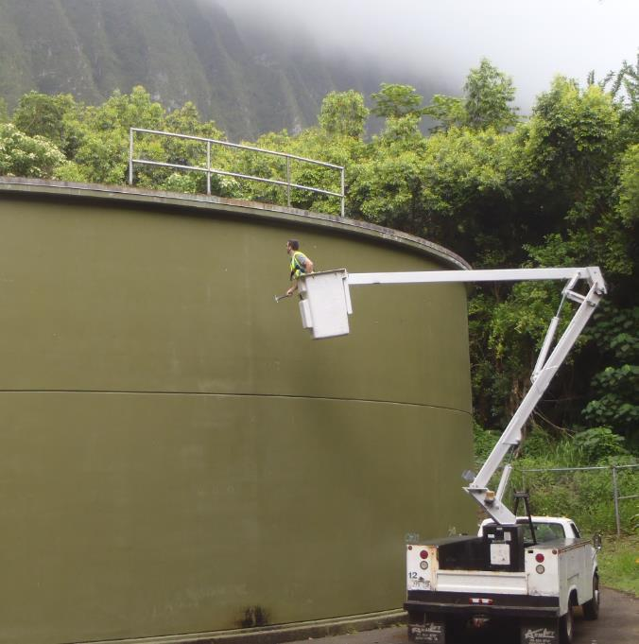
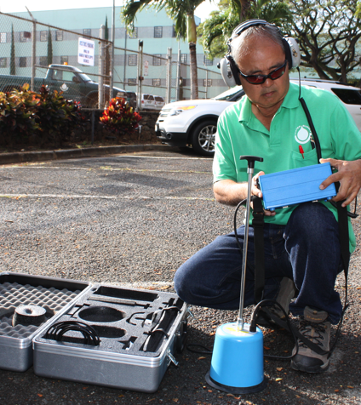
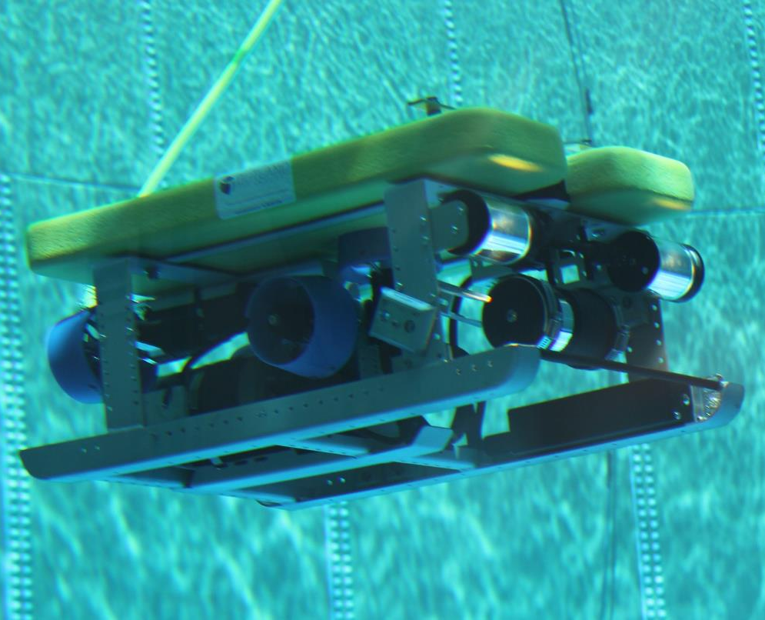
We conducted a comprehensive condition assessment of our water infrastructure
Extraction
Notes:
We evaluated the condition of every element of the system – wells, shafts, pumps, treatment facilities, reservoirs, and of course, our pipes. The assessments told us what shape our existing facilities are in today, where problems are developing, and what needs to be done to either extend their lifespans or replace them.
We also applied highly technological testing to help determine the condition of our pipes from the inside. This is not easy in a pressurized system filled with water. The purpose is to identify where there are signs of wear and tear in the pipes, where there is potential for problems to develop.

Slide 12
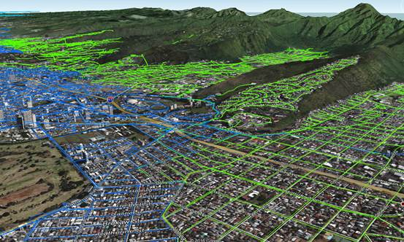
We analyzed the entire system for its capacity to handle the water needed for the 2040 population
Notes:
We analyzed the entire system for its capacity, its ability to deliver water where and when its needed. This was also extremely detailed and technologically-based. Some of the main things we learned about capacity are:
Additional water supply and storage are needed, mostly in Ewa-Waipahu, Leeward, and the lower part of the urban center.
We need to reduce pumping in some of our large wells to allow the aquifer to recover after droughts.
Capacity projects allow us to transfer water from where it is more abundant to where it is needed.
Among the greatest capacity needs are during maximum day demand, during the hottest summer months, when sources and pipelines have to produce and flow more water to meet the higher demands.

Slide 13
The BWS Water Master Plan…
Looks ahead 30 years
Evaluates the entire water system
Identifies necessary improvements
… Balances needs with costs of providing water to our customers

Slide 14
30-Year CIP by Category
Research & Development 3%
Capacity Expansion 39%
Renewal & Replacement
58%
Notes:
The next step was to develop at 30-Year Capital Improvement Plan to support the findings in the 30-Year Water Master Plan
This 30-year CIP plan is still under development. However some of the preliminary findings indicate the following:
The proposed budget is funded in three major categories and this slide shows the estimated percentage of projects in each category.
3% for Research and Development projects that includes studies, exploratory wells and project and construction management services.
58% for Renewal and Replacement projects that includes facility renovations and repairs and water main replacement projects.
39% for Capacity Expansion projects that includes new storage and transmission line to upgrade the water system to meet current and future demands.

Slide 15
30-Year CIP by Asset Type
Tools & Resources 1%
Non-potable
2%
Treatment 3%
Sources
8%
Facilities
13%
Pipelines
48%
Storage 13%
Pumps
12%
Notes:
This slide shows the breakdown of water system improvements by asset type shows that pipelines make up nearly half of the replacement value of the system.

Slide 16
The BWS Water Master Plan…
Looks ahead 30 years
Evaluates the entire water system
Identifies necessary improvements
Balances needs with costs of providing water to our customers

Slide 17
Financial Plan/Rates Schedule
WMP
Financial Plan
Rates
Engage Public
BWS Board Considers New Rates
Inform Public, Billing System Update and Testing
New Rates Effective
J | A | S | O | N | D | J | F | M | A | M | J | J | A | S | O | N | D | J | F | M | A | M | J | J | A | S | O | N | D | J
2017
2018
Notes:
We are building an approach to inform and engage a broader public audience as 2017 progresses. Our goal is to present a rates proposal to your board in mid-2018, allowing time to adjust and test the billing system for any modifications.

Slide 18
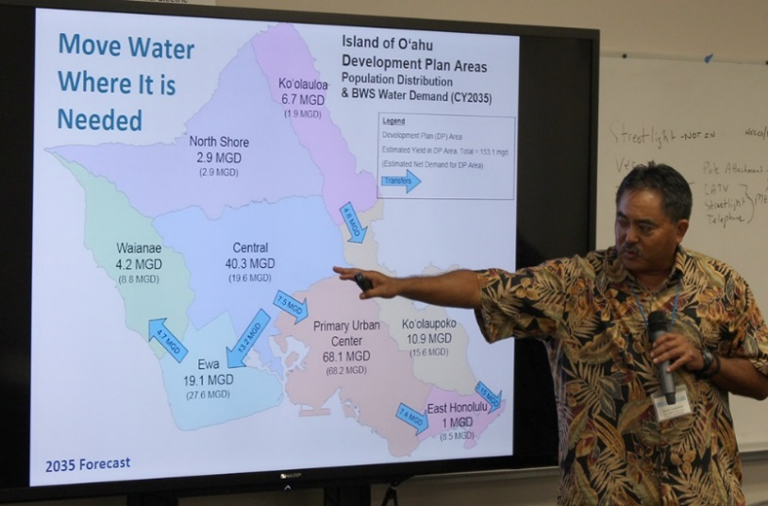
Stakeholder Advisory Group
Public Engagement
Established a Stakeholder Advisory Group (SAG) in April 2015
Created to improve the public’s understanding of our complex water issues and to seek input on our Water Master Plan, Financial Plan
and Rate Study.
Consists of 28 community/business leaders from various industries and interests.
Members provide recommendations on the Water Master Plan (WMP) and other BWS initiatives for BWS staff and Board to fully consider.
Notes:
A key component of our Water Master Plan is public engagement.
To accomplish this, a Stakeholder Advisory Group (SAG) was formed in 2015 to help the BWS improve the public’s understanding of our complex water issues and seek stakeholder input to our Water Mater Plan, Financial Plan and Rate Study.
There are 28 individuals who represent community groups and industries from across the island.
This is the first time the BWS has formally created an advisory group consisting of members of the public and we hope the group will provide valuable feedback and input for the BWS to consider.

Slide 19
The 27 Stakeholder Advisory Group members
represent diverse communities and interests.
Jackie Boland AARP Hawaii
Pono Chong Chamber of Commerce Hawaii Bill Clark Resident of Council District 6
Tim Brauer James Campbell Properties, LLC
Mark Fox The Nature Conservancy of Hawaii
Gregg Fraser Hawaii Restaurant Association
Neil Hannahs Kamehameha Schools
John Reppun Resident of Council District 3
Gladys Marrone Building Industry Association of Hawaii
Shari Ishikawa Hawaiian Electric Co.
Micah Kane Community Representative
Will Kane Mililani Town Community Association
Ralph Mesick First Hawaiian Bank
Helen Nakano Resident of Council District 5
Robbie Nicholas Community Representative Dean Okimoto Nalo Farms Inc.
Alison Omura Coca-Cola Bottling Co.
Bob Leinau Resident of Council District 2
Dick Poirier Resident of Council District 9
Elizabeth Reilly Resident of Council District 4
Cynthia Rezentes Resident of Council District 1
Francois Rogers Blue Planet Foundation
Josh Stanbro Hawaii Community Foundation
Cruz J. Vina, Jr. Resident of Council District 8
Christopher Wong Resident of Council District 7
Lee Yamamoto Marine Corps Base Hawaii
Suzanne Young Honolulu Board of Realtors
Notes:
We’ve have focused on selecting and attracting well respected individuals that represent the many diverse interests and perspectives among our customers and stakeholders.
The group is quite impressive. . .as advisory group members themselves have mentioned.
To help build relationships and hear, first hand, the views and concerns of these community leaders, we have been sitting down individually with each member and listening. We’ve completed 25 of these informal interviews, and it’s been a valuable learning experience. .

Slide 20
Navy’s Red Hill Bulk Storage Fuel Facility

Slide 21
BWS participation in Red Hill AOC
AOC Meetings with SMEs (including the BWS) in Honolulu:
December 3, 2015
May 10 – 12, 2016
October 4 – 6, 2016
February 15 – 16, 2017
In San Francisco:
August 31 – September 1, 2016
Public meeting on AOC
October 6, 2016

Slide 22
BWS letters regarding Red Hill & AOC
57 letters since 2014 to either the Navy, EPA, or DOH.
Received 13 separate replies. Of these 4 sent since the AOC has been signed.
32 letters sent regarding the AOC
11 on all AOC sections
7 specific to tanks/risk (AOC Sec 2, 3, 4, 5 and 8)
14 specific to groundwater studies (AOC Sec 6 & 7)

Slide 23
Red Hill GW Toxicology Study
BWS contracted toxicology experts to evaluate whether petroleum contaminants in groundwater under Red Hill tanks harmful to human health.
Experts worked independently of each other.
Used EPA approved methods to derive screening levels considered protective of public health.

Slide 24
Study results and comparison to others
Exponent | TPH-d Screening level | 210 ppb
INTERA | TPH-d Screening level | 162 ppb
Hawaii DOH | TPH-d Gross contamination EAL (taste and odor) | 100 ppb
Hawaii DOH | TPH-d drinking water toxicity EAL (Updated Nov. 2016) | 160 ppb
Massachusetts | TPH Drinking water guideline (2016) | 200 ppb
Minnesota | TPH Drinking water criteria (2013) | 200 ppb

Slide 25
Health risks above screening levels
Health effects of high levels of TPH-d
Changes in red blood cell counts
Noncancerous liver and kidney changes.
Consuming water containing TPH-d levels at or below the screening level is not expected to produce toxic effects

Slide 26
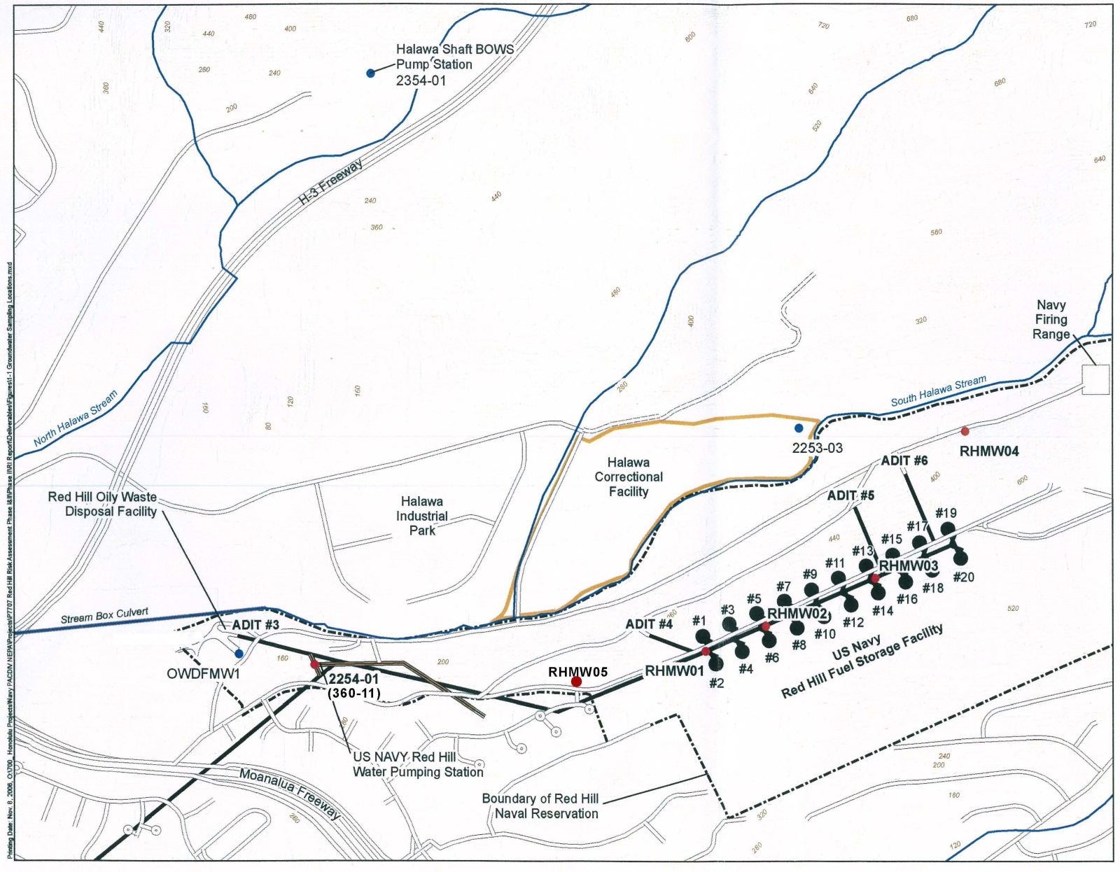
Groundwater contamination underneath Red Hill as of samples taken October 2016
Monitor Well (RHMW02)
1,300 ppb TPH diesel
300 ppb TPH oil
25 ppb 1-methylnaphthalene
9.2 ppb 2-methylnaphthalene
49 ppb Naphthalene
< 0.50 ppb Ethyl benzene
< 0.30 ppb Xylenes
Navy drinking water well
< 25 ppb TPH diesel
< 40 ppb TPH oil
< 0.10 ppb Naphthalene
< 0.50 ppb Ethyl benzene
RHMW06
Monitor Well (RHMW05)
< 25 ppb TPH diesel
< 40 ppb TPH oil
< 0.10 ppb 1-methylnaphthalene
< 0.10 ppb 2-methylnaphthalene
< 0.10 ppb Naphthalene
RHMW07
Monitor Well (RHMW01)
120 ppb TPH diesel
< 40 ppb TPH oil
< 0.10 ppb 1-methylnaphthalene
< 0.10 ppb 2-methylnaphthalene
< 0.10 ppb Naphthalene
Monitor Well (RHMW03)
65 ppb TPH diesel
< 40 ppb TPH oil
< 0.10 ppb 1-methylnaphthalene
< 0.10 ppb 2-methlynaphthalene
< 0.10 ppb Naphthalene

Slide 27
1/13/14
Tank 5 leak

Slide 28
Study conclusions
DOH gross contamination EAL of 100 ppb is protective of public health.
Clean-up the groundwater underneath and surrounding the Red Hill tanks
Use the gross contamination EAL of 100 ppb as the minimum clean-up level. This EAL is based on a taste and odor threshold and concurrently provides protection of public health.

Slide 29
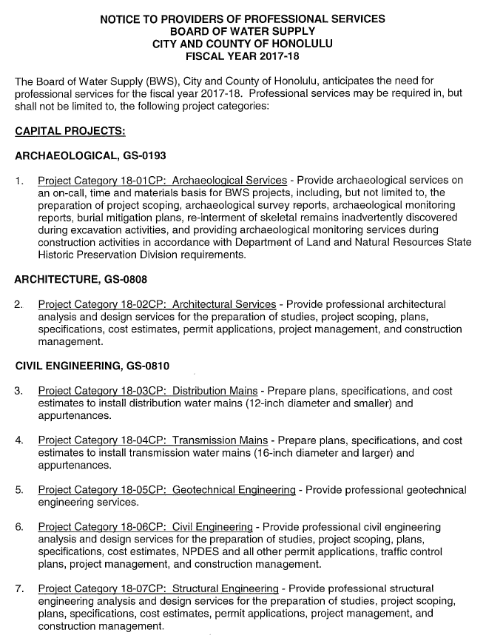
BWS Annual Ad for Professional Services FY 2017-2018
BWS website – March 17, 2017
http://www.boardofwatersupply.com/procurement/professional-services/projects
Submittals due: April 28, 2017
To: BWS Office of Procurement

Slide 30
Questions?

