Slide 1

FACILITIES DEVELOPMENT BRANCH
Dedicated to student achievement by providing innovative, nurturing and safe learning environments in a fiscally responsible and sustainable manner

Slide 2
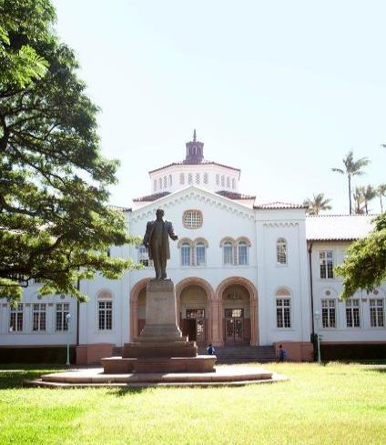
Department of Education Updates & Future Projects
2017 Joint State-City-Counties
Symposium
April 6, 2017
Hale Koa Hotel

Slide 3

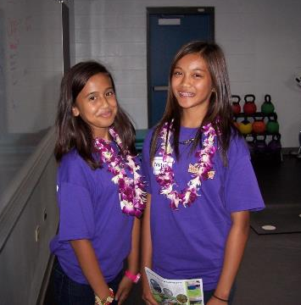
MAHALO

Slide 4
Agenda
Applying for work with the DOE
  Procurement Requirements
  New Online Application Process
  Improving your chances of selection
DOE as a client – Get to Know Us
New Initiatives & A Glimpse towards the Future for DOE Facilities
  Jacobs Study
  IT and Online Changes and Resources
  Sustainability & Heat Abatement
Upcoming projects and funding

Slide 5
Procurement of Professional Services
Governed by HRS 103D-304 – Professional Services
STEP 1 NOTICE to Providers of Professional
Services Post notice on Procurement Notices
System (PNS) at
http://spo.hawaii.gov/for-vendors/bidding-opportunities/
http://www.hawaiipublicschools.org/ConnectWithUs/Vendors/Pages/Home.aspx
Notes:
SO, NOW LET’S GO OVER THE PROCESS SO YOU KNOW WHAT TO EXPECT.
READ SLIDE

Slide 6
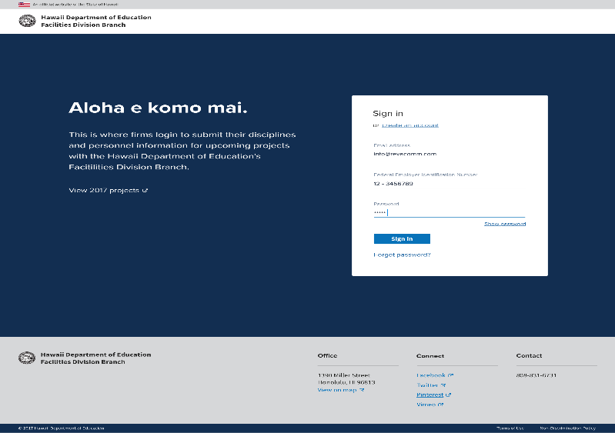

Slide 7
Online Application Process
Create an account
  Fill in information on application form
  Update information anytime
  Keep information current
  Phase I : will still need to upload Form 120
  Phase II: fillable form will be online
  Receive automatic notices and updates

Slide 8
Procurement of Professional Services
STEP 2 REVIEW COMMITTEE
Minimum of three qualified committee persons
Shall review and evaluate all submissions
Prepare a list of qualified applicants

Slide 9
Procurement of Professional Services
STEP 3 SELECTION COMMITTEE
Minimum of three qualified committee persons from list of qualified staff;
Utilize selection criteria in descending order of importance:
  1. Experience and professional qualifications relevant to the project type;
  2. Past performance on similar projects
  3. Capacity to accomplish the work in the required time; and
  4. Any additional criteria as determined in writing by the selection committee, to be relevant.
Notes:
READ SLIDE

Slide 10
Procurement of Professional Services
Evaluate the submissions.
Conduct confidential discussions
Rank a minimum of three providers, submit to head of the purchasing agency for approval (HOPA)
HOPA or designee negotiates a contract with first ranked consultant
  In FDB, this authority is delegated to the project coordinator
Notes:
READ SLIDE

Slide 11
Procurement of Professional Services
  1. If not able to reach agreement, negotiate with second ranked consultant
  2. If not able to reach agreement with any on the initial list, selection committee may be asked to submit a minimum of three additional consultants for HOPA to resume negotiations
  3. Contract file shall contain all documentation to support selection.
Notes:
READ SLIDE

Slide 12
Procurement of Professional Services
STEP 4 AWARD
Awards $5,000 or more posted on SPO webpage within 7 days of award.
At the SPO webpage
http://www.hawaii.gov/spo/SPO/awards
Notes:
READ SLIDE

Slide 13
Procurement of Professional Services
STEP 5 DEBRIEFING of non-selected provider
Non-selected provider may submit a written request for debriefing within 3 working days after posting of
award
Agency shall conduct debriefing within 7 working days
STEP 6 PROTEST
Shall be filed within 5 working days of the posting of the award; or
Following a debriefing, a protest shall be filed within 5 working days
Notes:
READ SLIDE

Slide 14
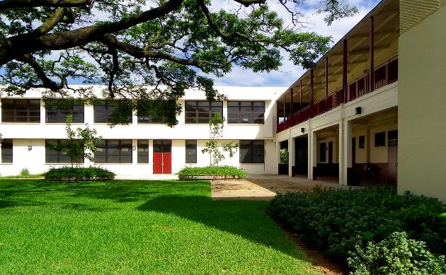
The DOE as a Client – How to Improve Your Chances of being selected

Slide 15
How to Improve Your Chance of being selected
Past Performance: Provide good service and deliver a successful project.
  Response Time
  Meeting project schedules
What if you have no past performance record with DOE as a prime consultant?
  Past performance as a sub-consultant
  Past performance with other governmental agencies
  Past performance with other educational entities
  Past performance outside Hawaii
Notes:
SO, NOW HOW DO YOU INCREASE YOUR CHANCES?
READ SLIDE

Slide 16
How to Improve Your Chance of being selected
  Market yourself by:
    Provide key staff qualifications for the discipline(s) your firm is applying for;
    Let us know if you have staff with prior DOE experience;
    Introduce yourself and meet us in person – ‘Meet & Greet’
    Provide relevant information on similar projects or project types
    Relevant information on other projects that may not be listed
    Update your submittal information promptly when your qualifications change
Notes:
READ SLIDE

Slide 17

Initiatives and a Glimpse towards the Future In DOE Facilities

Slide 18
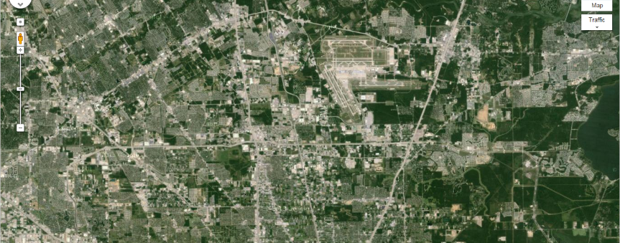

Facilities Master Plan Study and
Gap Analysis

Slide 19

Enable Data Driven Decisions
Enable Facilities Assessments
Inform Strategic Planning Decisions
Inform decisions regarding where to prioritize limited resources
Promote Equity
Encourage data driven decision making

Slide 20
Building Inventory by District

Slide 21

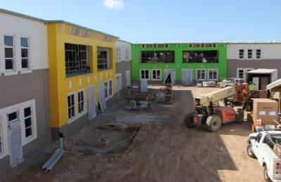
Space per Student
National Average: 104 to 161 sq ft per student
Hawaii Average: 107 to 143 sq ft per student

Slide 22



Facility Requirements Driven by HIDOE Standards and Enrollment
Requirements are based on current prevailing HIDOE standards
  2008 Elementary School Education Specifications
  2006 Middle and Intermediate School Education Specifications
  2006 High School Education Specifications
Required room quantities and sizes driven by Current 2015-16 and Projected 2019-2020 Enrollment.

Slide 23
DOE ED SPECS Space Standards
Elementary 76,395 sq ft for 750 students = 102 sq ft per student
Middle 121,820 sq ft for 1,050 students = 116 sq ft per student
High 207,649 sq ft for 1,600 students = 130 sq ft per student

Slide 24



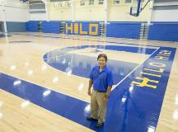
Focus of Gap Analysis (Existing Space vs HIDOE Ed Spec Standard)
Academic Building Spaces
  General Classrooms
  Special Education Classrooms
  Science Classrooms
  Arts & BPA Classrooms
  Portable Classrooms
Support Building Spaces
  Administration
  Library Media Center
  Cafeteria
  Gymnasium
  Locker/Shower

Slide 25
Gap Analysis: Admin Building based on 2015-2016 Current Enrollment
15 schools with significant administration space deficiencies
Eg. Pahoa Elementary admin is a wood building beyond its expected life sized for 12% of required space. Administration is operating in six other buildings, including 3 classrooms.
Eg. Kaewai Elementary admin is a 1956 CMU building that is 24% of standard for its enrollment. Administration is making due by using 6 classrooms for other uses.

Slide 26
Facilities IT and Online Resources
AHERA documents will be available via Dropbox
Eplan Room documents will be available via Dropbox
Consultant Reviews will be posted to consultant account

Slide 27
DOE Campus Viewer
http://165.248.35.76/HIDOE_CampusViewer/
Combines Jacobs Database with GIS Base Layer

Slide 28
DOE Weather Stations on Weather Underground
https://www.wunderground.com/us/hi/honolulu
Most High Schools and many Elementary, Middle Schools on Oahu
Some neighbor island schools

Slide 29

SUSTAINABILITY IN HAWAII’S PUBLIC SCHOOLS

Slide 30
Photovoltaic Systems
DOE’s first PV project initiated for 30 Oahu schools
DOE’s next PV project initiated for all 15 Kauai Schools
Ka Hei Program initiated to provide PV for all remaining 200+ schools.

Slide 31
30 Oahu Pilot Schools – 2015 data

Slide 32
15 Kauai Schools – 2015 to date

Slide 33
Heat Abatement and Thermal Comfort - Study
Study commissioned through the Hawaii Natural Energy Institute to analyze thermal comfort issues and recommend passive cooling strategies.
Study completed in March 2015, just in time for the hottest summer in Hawaii history!

Slide 34
Heat Abatement and Thermal Comfort - Study
Study identified passive cooling measures:
  Thermal Flushing
  Cool Roofs
  Insulation
  Increased ventilation and air movement
  Shading devices
  Landscaping

Slide 35
Classrooms with Air Conditioning
As of November 4, 2015
256 Schools Responding (100%)
Total # of Schools: 256
Total # of Classrooms: 11,701
Total # of AC’d Classrooms: 4,358
% of AC’d Classrooms: 37%

Slide 36
Classrooms with Air Conditioning
As of November 4, 2015
256 Schools Responding (100%)
Totals Excluding 100% AC’d Schools:
Total # of Schools: 216
Total # of Classrooms: 10,022
Total # of AC’d Classrooms: 2,679
% of AC’d Classrooms: 27%

Slide 37
Funding for Fiscal Year 2017-2018 KPI Categories
House Draft = $434.4 million
Senate Draft = $430.7 million
Highlights:
  New School for Kakaako
  New Middle School for Kapolei
  Renovations for Academies

Slide 38
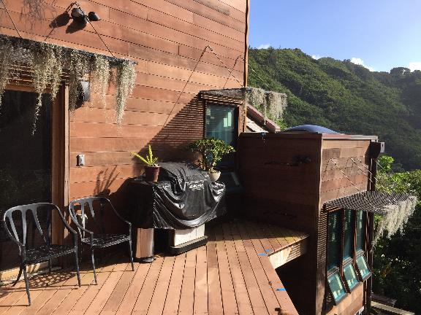
Final Thoughts – Be Creative

Slide 39
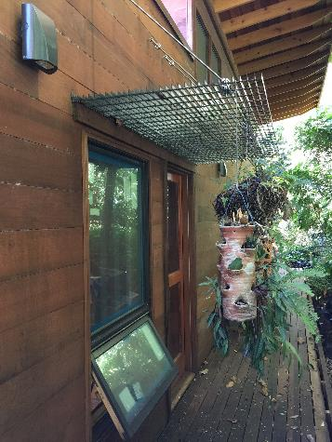
Think Outside of the Box

Slide 40
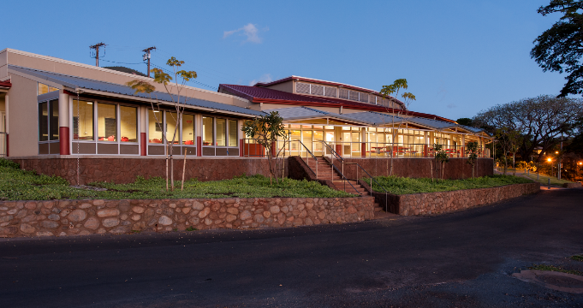
QUESTIONS?

